Slide 1

Instrumentation and Control
CSE 325
Reading maketh a full man; conference a ready man; and writing an exact man." - Francis Bacon
Mehedi Hasan
Lecturer
Computer Science and Engineering(CSE)
Daffodil International University(DIU)

Slide 2
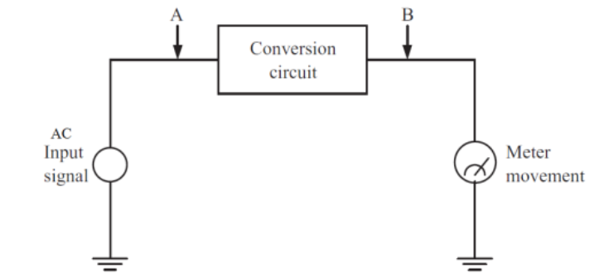
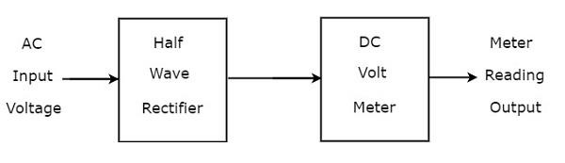
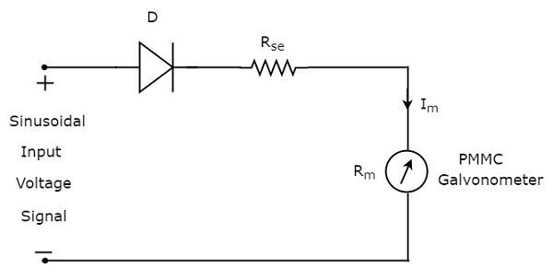
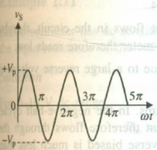
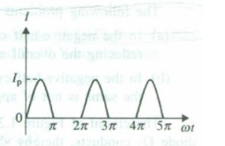
Rectifier-based AC Meters
Half-wave rectifier AC Meter:

Slide 3
Rectifier-based AC Meters
Half-wave rectifier AC Meter:
Disadvantages:
In negative half-cycle, reverse current flows through the circuit as a result ,reduces average value of current and so meter reads lower than actual.
High peak inverse voltage (PIV) rating of Diode is required.

Slide 4
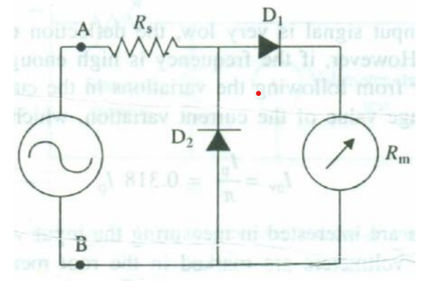
Rectifier-based AC Meters
Solution:
In negative half-cycle, D2 conducts. And so, no negative current flows through the meter movement. Because of this diode action, the circuit is protected from reverse current, and the meter only sees the positive portion of the waveform.
PIV rating requirement is much less than the large peak input voltage(Vp).

Slide 5
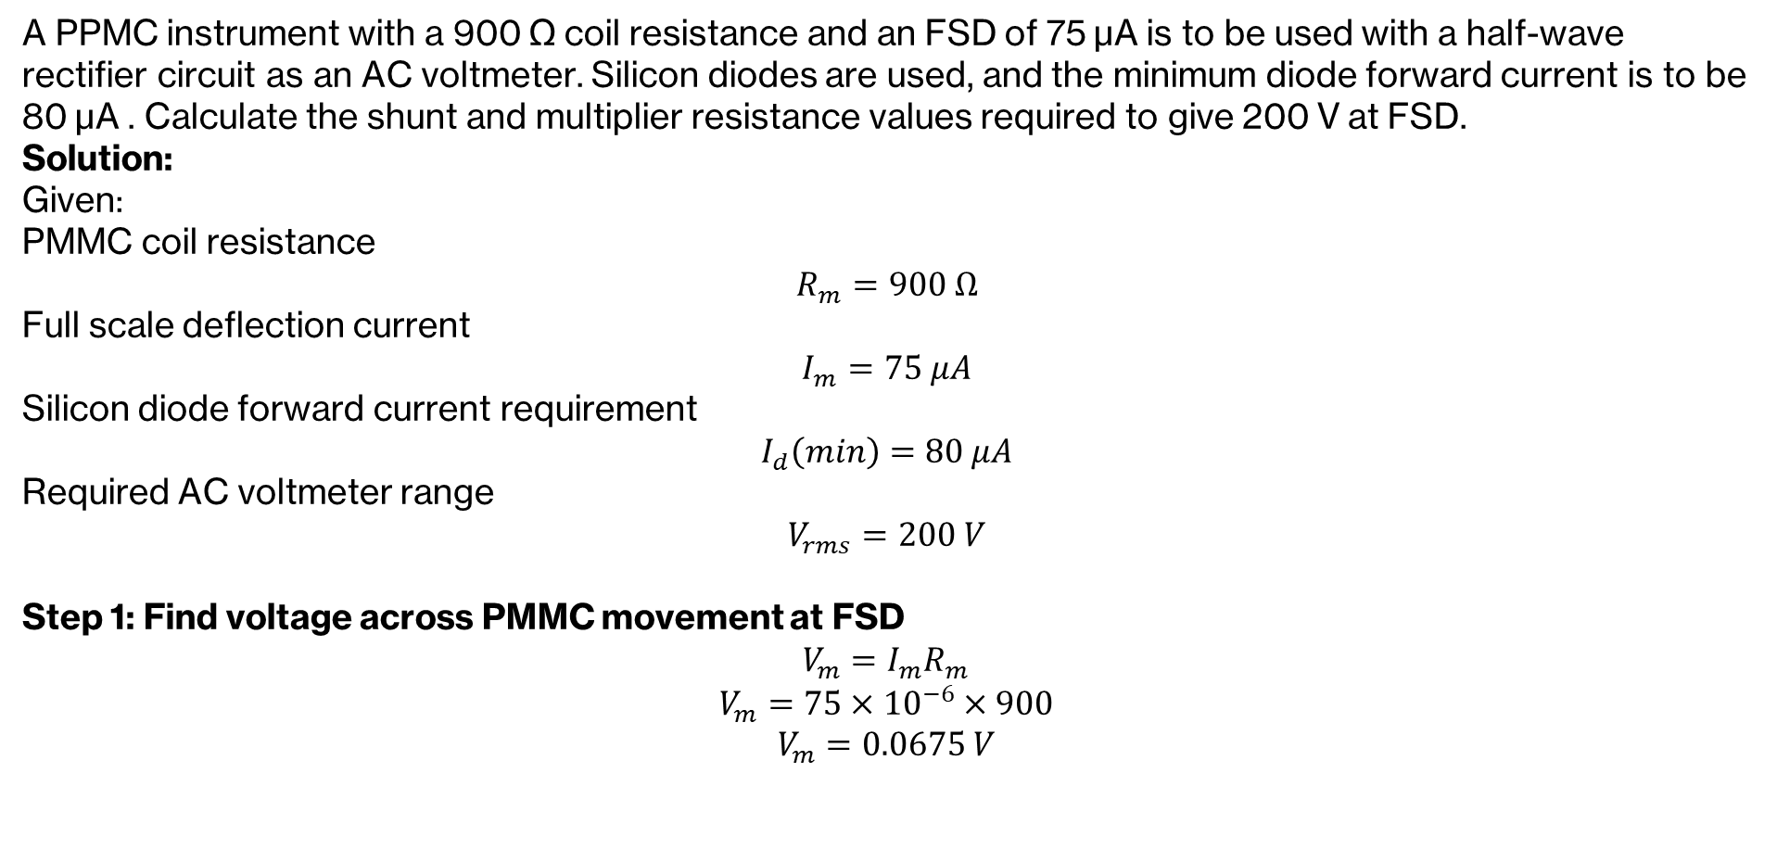

Rectifier-based AC Meters
A PPMC instrument with a 900 Ω coil resistance and an FSD of 75 μA is to be used with a half‑wave rectifier circuit as an AC voltmeter. Silicon diodes are used, and the minimum diode forward current is to be 80 μA . Calculate the shunt and multiplier resistance values required to give 200 V at FSD.
Solution:
Given:
PMMC coil resistance
$$R_{m}=900 Ω$$
Full scale deflection current
$$I_{m}=75 μA$$
Silicon diode forward current requirement
$$I_{d}\left(min\right)=80 μA$$
Required AC voltmeter range
$$V_{rms}=200 V$$
Step 1: Find voltage across PMMC movement at FSD
$$V_{m}=I_{m}R_{m}$$
$$V_{m}=75×{10}^{−6}×900$$
$$V_{m}=0.0675 V$$
Step 2: Calculate shunt resistance
The diode requires at least $80 μA$forward current for conduction.
Meter takes only:
$$75 μA$$
So extra current through shunt:
$$I_{sh}=80−75$$
$$I_{sh}=5 μA$$
Since shunt is parallel with meter:
$$R_{sh}=\frac{V_{m}}{I_{sh}}$$
$$R_{sh}=\frac{0.0675}{5×{10}^{−6}}$$
$$R_{sh}=13.5 kΩ$$
Therefore,
$$\boxed{R_{sh}=13.5 kΩ}$$

Slide 6
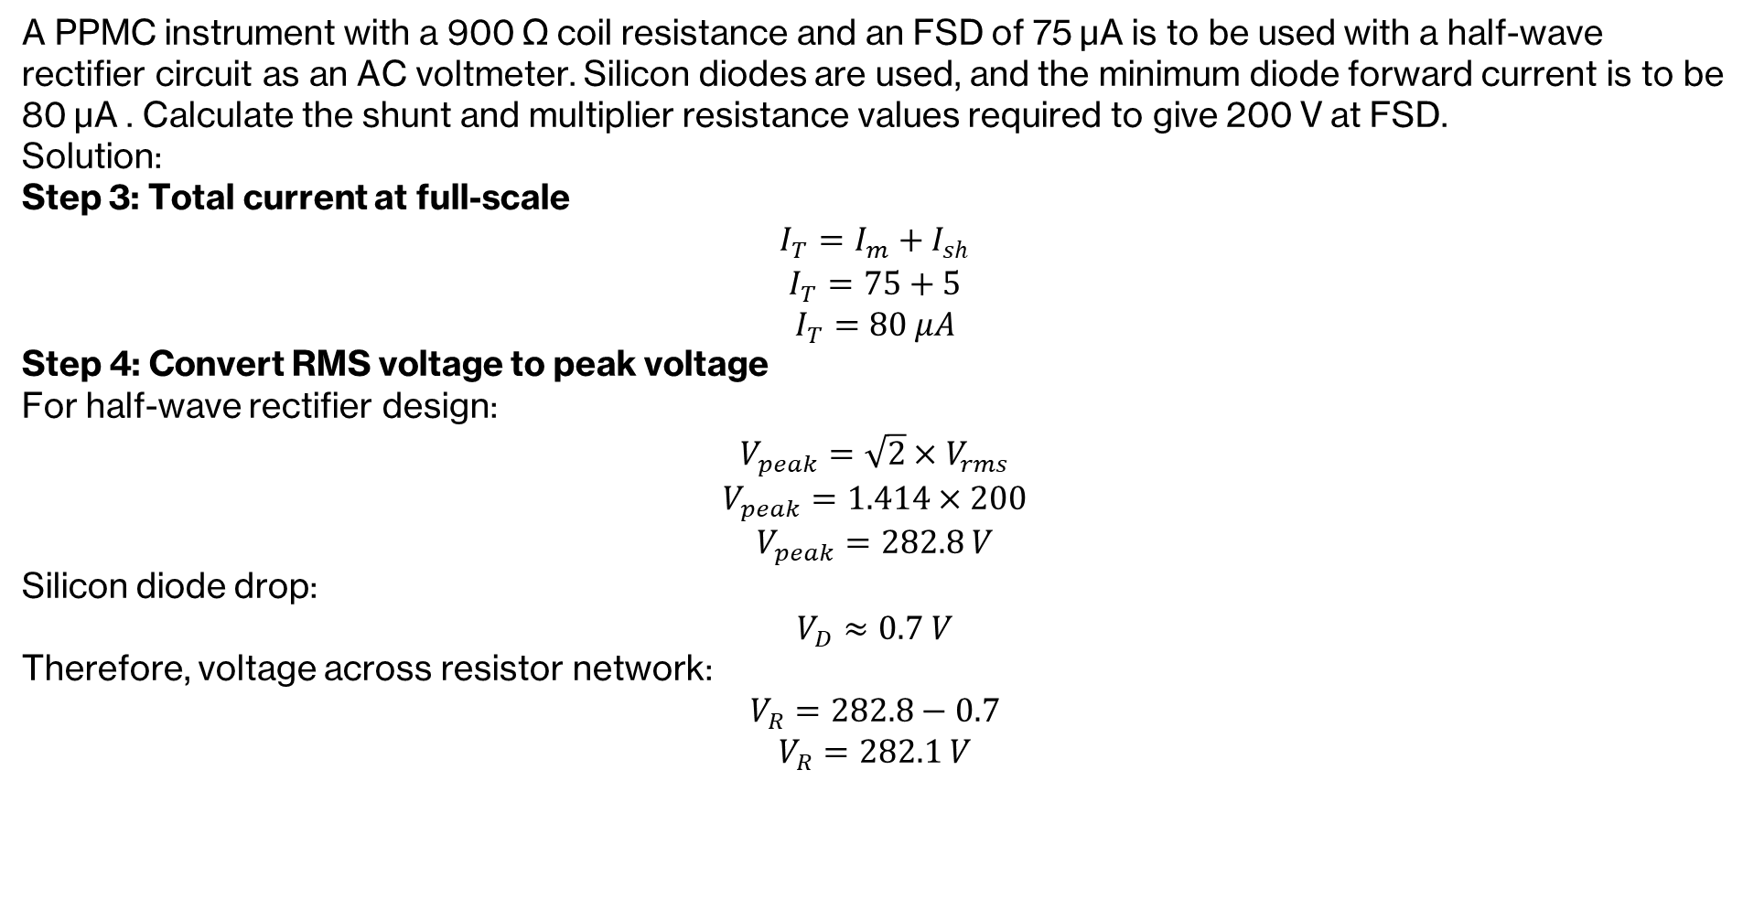

Rectifier-based AC Meters
A PPMC instrument with a 900 Ω coil resistance and an FSD of 75 μA is to be used with a half‑wave rectifier circuit as an AC voltmeter. Silicon diodes are used, and the minimum diode forward current is to be 80 μA . Calculate the shunt and multiplier resistance values required to give 200 V at FSD.
Solution:
Step 3: Total current at full-scale
$$I_{T}=I_{m}+I_{sh}$$
$$I_{T}=75+5$$
$$I_{T}=80 μA$$
Step 4: Convert RMS voltage to peak voltage
For half-wave rectifier design:
$$V_{peak}=\sqrt{2}×V_{rms}$$
$$V_{peak}=1.414×200$$
$$V_{peak}=282.8 V$$
Silicon diode drop:
$$V_{D}≈0.7 V$$
Therefore, voltage across resistor network:
$$V_{R}=282.8−0.7$$
$$V_{R}=282.1 V$$
Step 5: Find total resistance required
$$R_{total}=\frac{V_{R}}{I_{T}}$$
$$R_{total}=\frac{282.1}{80×{10}^{−6}}$$
$$R_{total}=3.526×{10}^{6} Ω$$
$$R_{total}=3.526 MΩ$$
Step 6: Effective resistance of meter branch
$$R_{p}=R_{m}∥R_{sh}$$
$$R_{p}=\frac{900×13500}{900+13500}$$
$$R_{p}≈844 Ω$$
Step 7: Multiplier resistance
$$R_{s}=R_{total}−R_{p}$$
$R_{s}=3.526 MΩ−844 Ω$ =$3.525 MΩ$

Slide 7
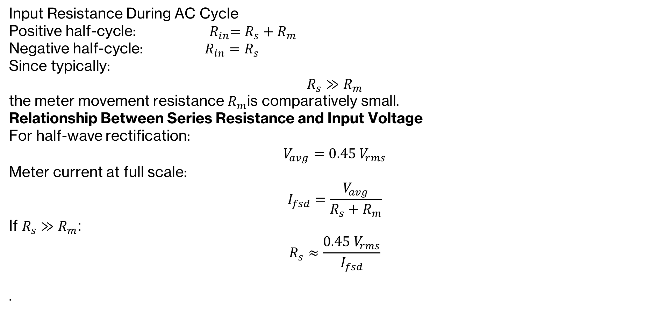
Half-Wave AC Voltmeter Sensitivity
Input Resistance During AC Cycle
Positive half-cycle:${ R}_{in}=R_{s}+R_{m}$
Negative half-cycle: $R_{in}=R_{s}$
Since typically:
$$R_{s}≫R_{m}$$
the meter movement resistance $R_{m}$is comparatively small.
Relationship Between Series Resistance and Input Voltage
For half-wave rectification:
$$V_{avg}=0.45 V_{rms}$$
Meter current at full scale:
$$I_{fsd}=\frac{V_{avg}}{R_{s}+R_{m}}$$
If $R_{s}≫R_{m}$:
$$R_{s}≈\frac{0.45 V_{rms}}{I_{fsd}}$$
.

Slide 8
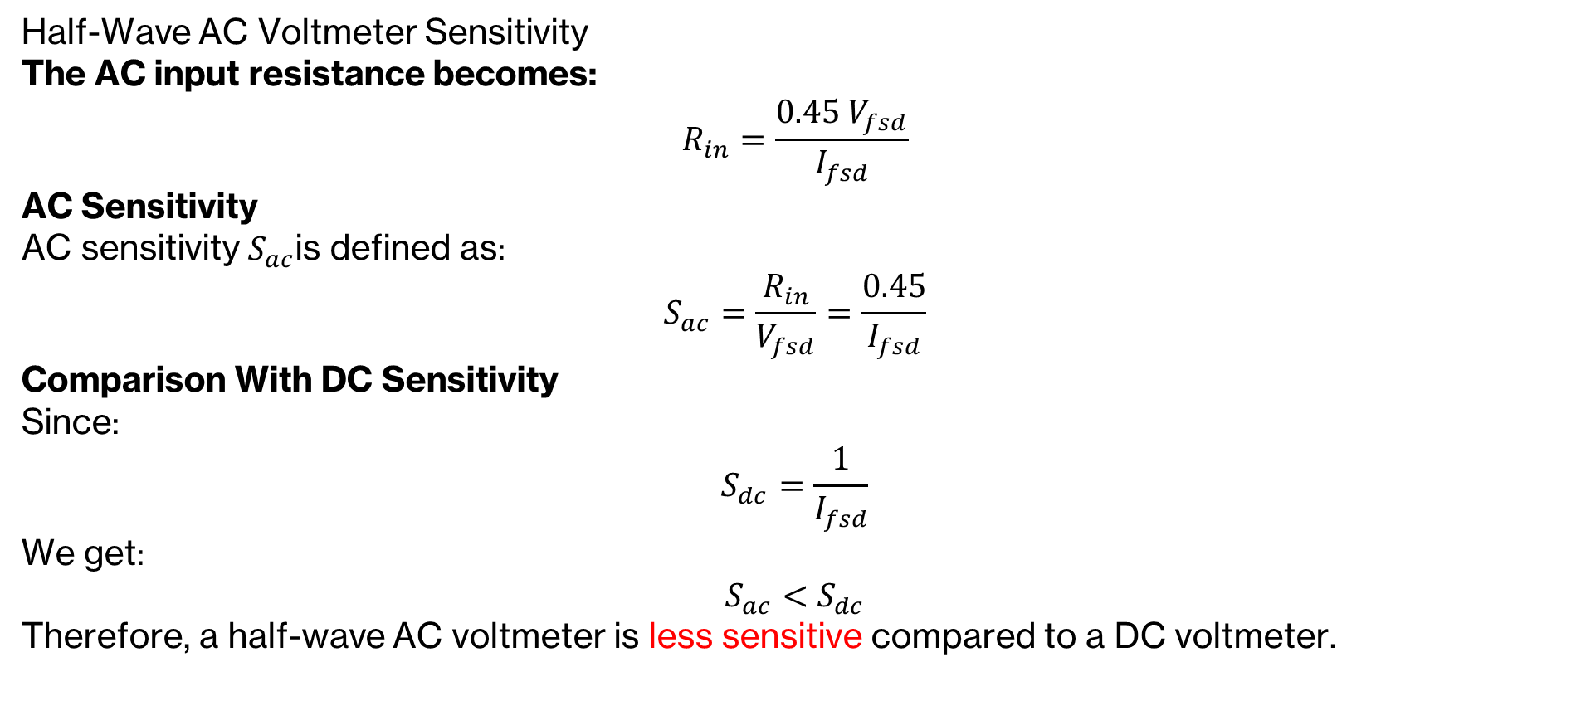
Half-Wave AC Voltmeter Sensitivity
Half-Wave AC Voltmeter Sensitivity
The AC input resistance becomes:
$$R_{in}=\frac{0.45 V_{fsd}}{I_{fsd}}$$
AC Sensitivity
AC sensitivity $S_{ac}$is defined as:
$$S_{ac}=\frac{R_{in}}{V_{fsd}}=\frac{0.45}{I_{fsd}}$$
Comparison With DC Sensitivity
Since:
$$S_{dc}=\frac{1}{I_{fsd}}$$
We get:
$$S_{ac}<S_{dc}$$
Therefore, a half-wave AC voltmeter is less sensitive compared to a DC voltmeter.

Slide 9
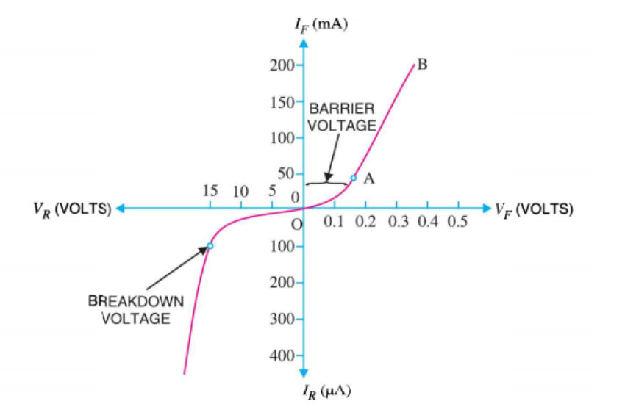
Non-linearity in Lower RMS Ranges
Diode I-V characteristics are inherently non-linear
This non-linearity is most noticeable at low currents and low RMS voltages
At small signals, the diode’s forward drop clips part of the waveform
The lower end of the scale becomes compressed and non-linear
Non-linearity can be reduced by operating the diode at higher current levels

Slide 10
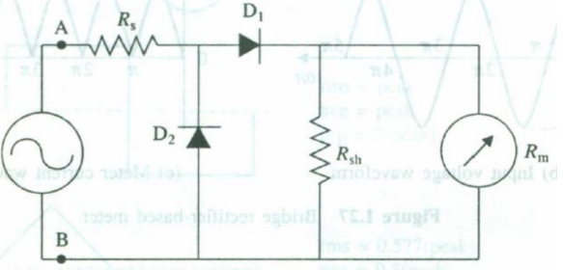
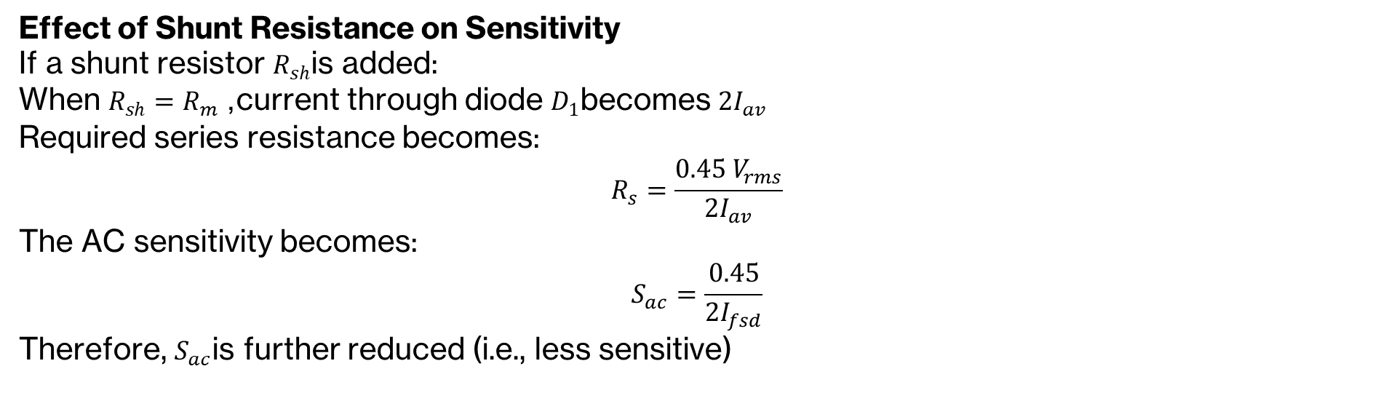
Non-linearity in Lower RMS Ranges
Effect of Shunt Resistance on Sensitivity
If a shunt resistor $R_{sh}$is added:
When $R_{sh}=R_{m}$, current through diode $D_{1}$becomes $2I_{av}$
Required series resistance becomes:
$$R_{s}=\frac{0.45 V_{rms}}{2I_{av}}$$
The AC sensitivity becomes:
$$S_{ac}=\frac{0.45}{2I_{fsd}}$$
Therefore, $S_{ac}$is further reduced (i.e., less sensitive)

Slide 11
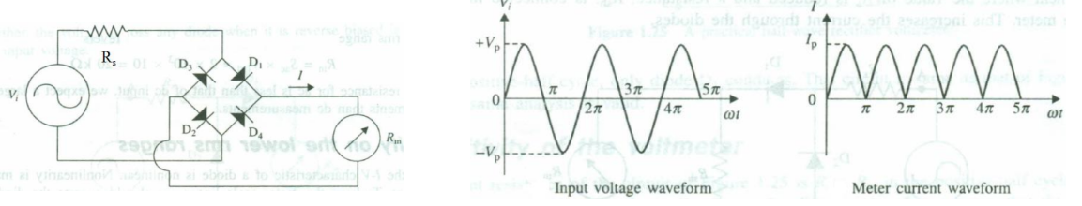
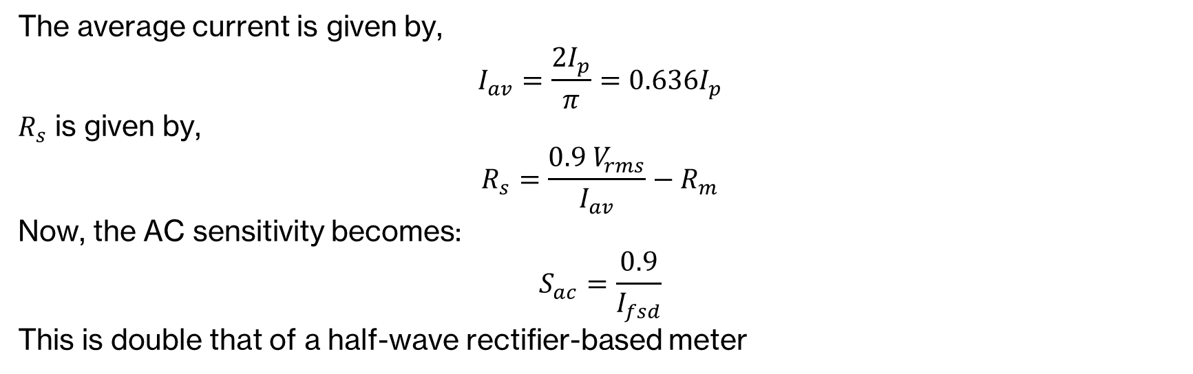
Full-wave Rectifier-based Meter
The average current is given by,
$$I_{av}=\frac{2I_{p}}{π}=0.636I_{p}$$
$R_{s}$ is given by,
$$R_{s}=\frac{0.9 V_{rms}}{I_{av}}−R_{m}$$
Now, the AC sensitivity becomes:
$$S_{ac}=\frac{0.9}{I_{fsd}}$$
This is double that of a half-wave rectifier-based meter

Slide 12
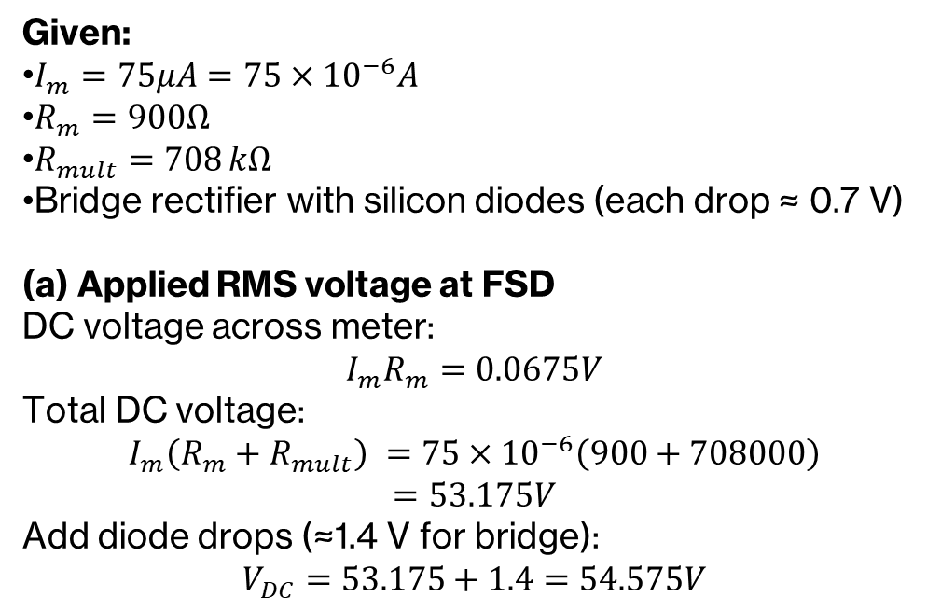
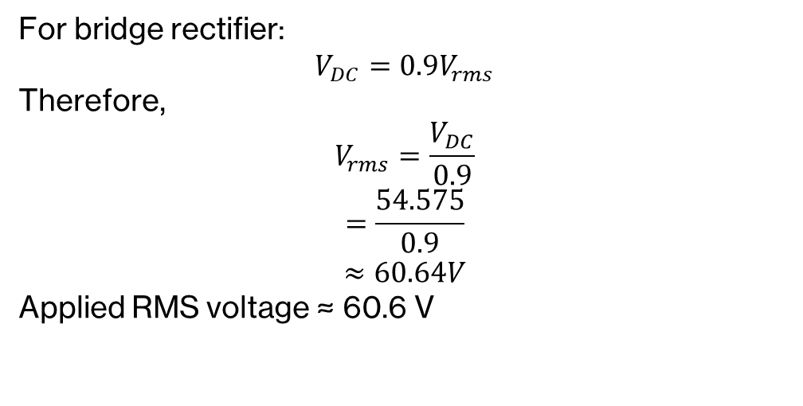
Full-wave Rectifier-based Meter
An AC voltmeter uses a bridge rectifier with silicon diodes and a PPMC instrument with FSD 75 µA. If the meter coil resistance is 900 Ω and the multiplier resistor is 708 kΩ:
(a) Calculate the applied RMS voltage when the voltmeter indicates FSD. (b) Determine the new multiplier resistance required for the voltmeter to change its range to 300 V FSD. (c) Calculate the sensitivity of the AC voltmeter.
Given:
$I_{m}=75μA=75×{10}^{−6}A$
$R_{m}=900Ω$
$R_{mult}=708 kΩ$
Bridge rectifier with silicon diodes (each drop ≈ 0.7 V)
(a) Applied RMS voltage at FSD
DC voltage across meter:
$$I_{m}R_{m}=0.0675V$$
Total DC voltage:
$$I_{m}\left(R_{m}+R_{mult}\right) =75×{10}^{−6}\left(900+708000\right)$$
$$=53.175V$$
Add diode drops (≈1.4 V for bridge):
$$V_{DC}=53.175+1.4=54.575V$$
For bridge rectifier:
$$V_{DC}=0.9V_{rms}$$
Therefore,
$$V_{rms}=\frac{V_{DC}}{0.9}$$
$$=\frac{54.575}{0.9}$$
$$≈60.64V$$
Applied RMS voltage ≈ 60.6 V

Slide 13
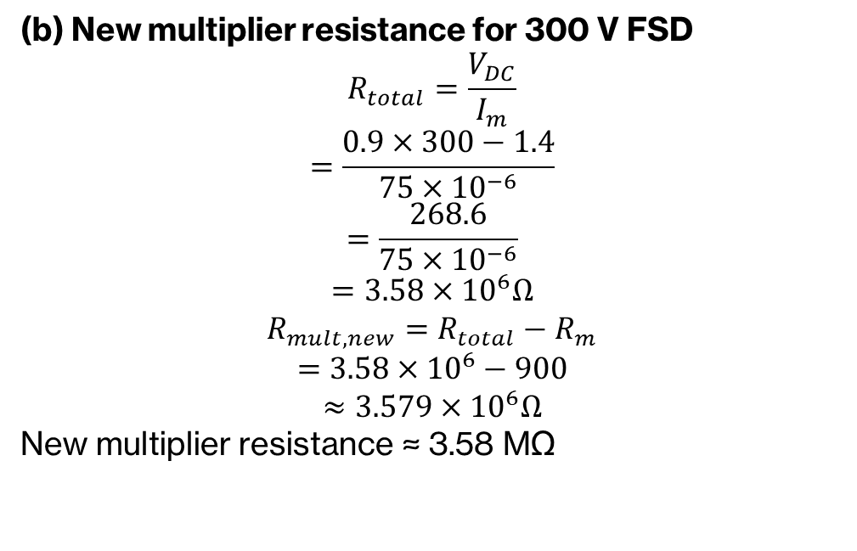
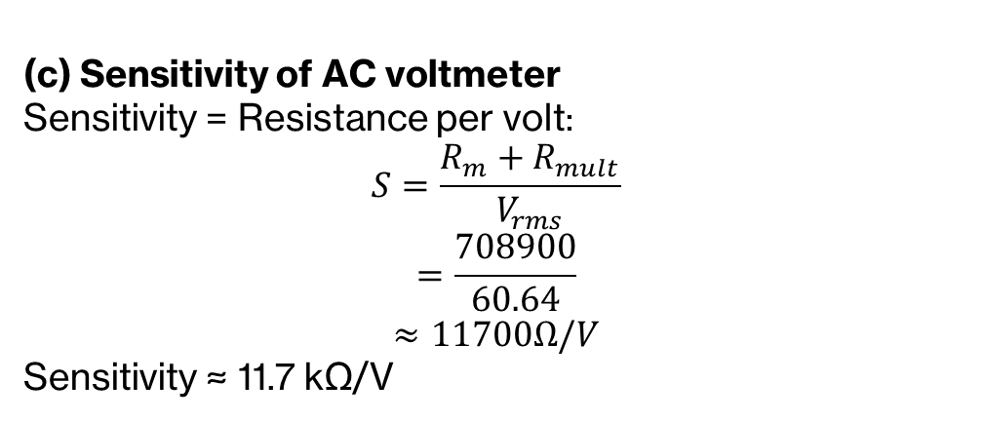
Full-wave Rectifier-based Meter
An AC voltmeter uses a bridge rectifier with silicon diodes and a PPMC instrument with FSD 75 µA. If the meter coil resistance is 900 Ω and the multiplier resistor is 708 kΩ:
(a) Calculate the applied RMS voltage when the voltmeter indicates FSD. (b) Determine the new multiplier resistance required for the voltmeter to change its range to 300 V FSD. (c) Calculate the sensitivity of the AC voltmeter.
(c) Sensitivity of AC voltmeter
Sensitivity = Resistance per volt:
$$S=\frac{R_{m}+R_{mult}}{V_{rms}}$$
$$=\frac{708900}{60.64}$$
$$≈11700Ω/V$$
Sensitivity ≈ 11.7 kΩ/V
(b) New multiplier resistance for 300 V FSD
$$R_{total}=\frac{V_{DC}}{I_{m}}$$
$$=\frac{0.9×300−1.4}{75×{10}^{−6}}$$
$$=\frac{268.6}{75×{10}^{−6}}$$
$$=3.58×{10}^{6}Ω$$
$$R_{mult,new}=R_{total}−R_{m}$$
$$=3.58×{10}^{6}−900$$
$$≈3.579×{10}^{6}Ω$$
New multiplier resistance ≈ 3.58 MΩ

Slide 14
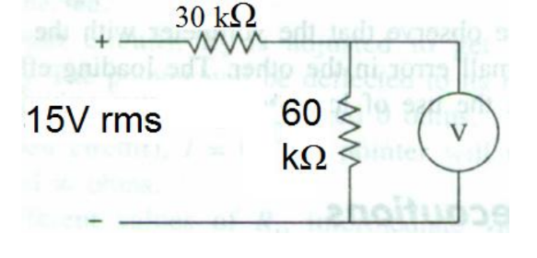
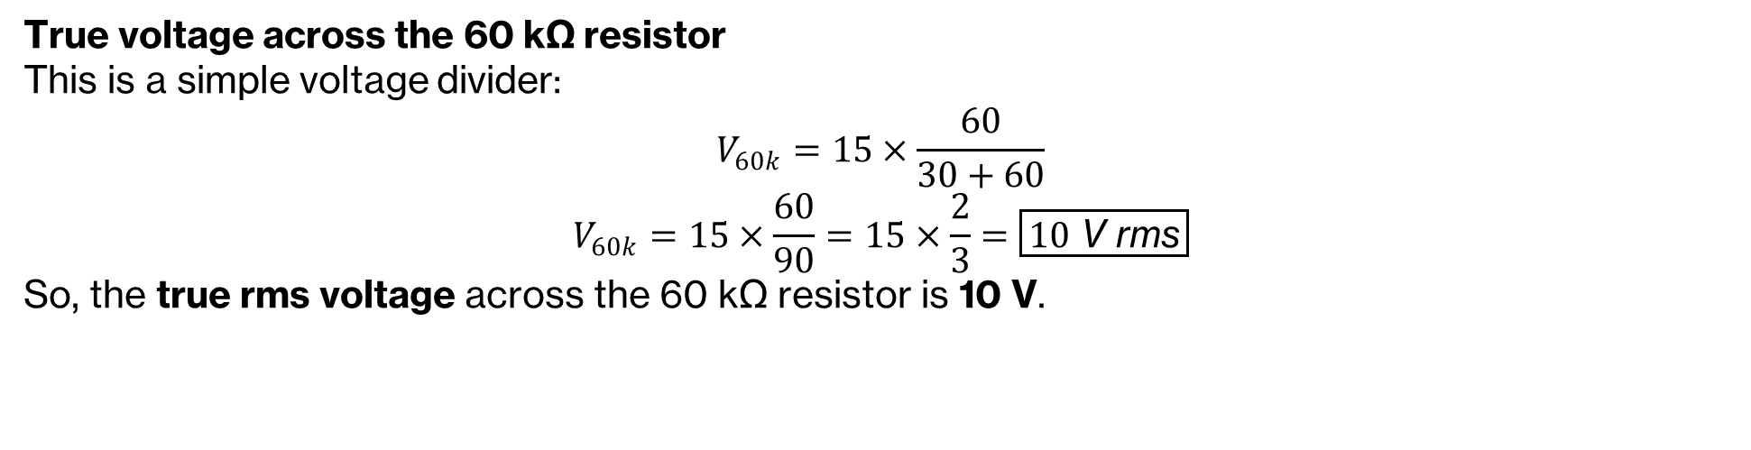
Electronic AC Ammeter
The ac voltmeter is used to measure voltage V across 60 kΩ resistor in the following circuit. What is the minimum voltage reading that should be observed?
The parameters of the ac voltmeter are:
Full-wave rectification
100 μA meter movement
15 V range
Accuracy = ± 3% fsd
True voltage across the 60 kΩ resistor
This is a simple voltage divider:
$$V_{60k}=15×\frac{60}{30+60}$$
$$V_{60k}=15×\frac{60}{90}=15×\frac{2}{3}=\boxed{10 \text{V} \text{rms}}$$
So, the true rms voltage across the 60 kΩ resistor is 10 V.

Slide 15
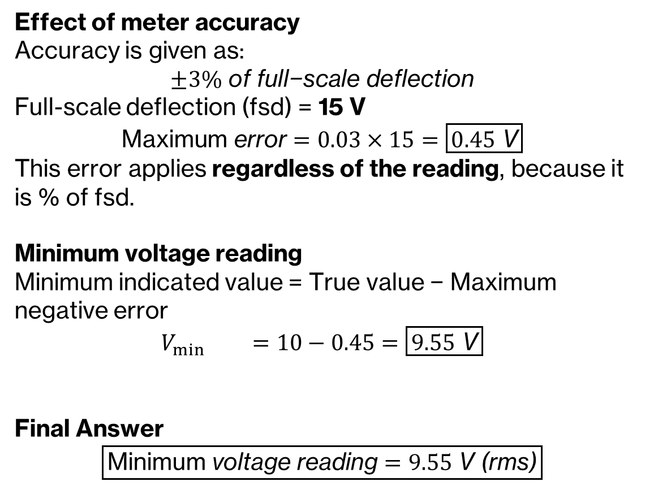
Electronic AC Ammeter
Effect of meter accuracy
Accuracy is given as:
$$±3\% \text{of} \text{full}\text{−}\text{scale} \text{deflection}$$
Full-scale deflection (fsd) = 15 V
$$\text{Maximum} \text{error}=0.03×15=\boxed{0.45 \text{V}}$$
This error applies regardless of the reading, because it is % of fsd.
Minimum voltage reading
Minimum indicated value = True value − Maximum negative error
$$V_{min{}}=10−0.45=\boxed{9.55 \text{V}}$$
Final Answer
$$\boxed{\text{Minimum} \text{voltage} \text{reading}=9.55 \text{V}\text{ (}\text{rms}\text{)}}$$

